Slide 1
Programming with Lists – Part 1
Basic functions that manipulate lists

Slide 2
Length
Write a function, called length, that takes a list as input and returns the number of elements in the list.
fun length [] = 0
| length (x::xs) = 1 + length xs;
length [1,2,3];
(1 + (1 + (1 + 0)))

Slide 3
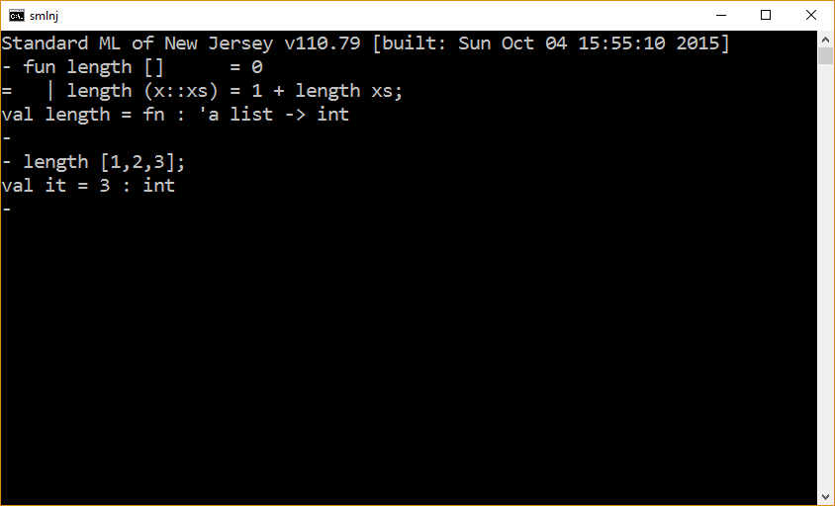

Slide 4
Sum List
Write a function, called sumList, that takes an integer list as input and returns the sum of the elements of the list.
fun sumList [] = 0
| sumList (x::xs) = x + sumList xs;
sumList [1,2,3];
(1 + (2 + (3 + 0)))

Slide 5


Slide 6
Binary Op Over List Elements
Write a function, called foldRight, that takes as input (1) a binary function opFn, (2) an initial (identity) value v, and (3) an integer list as input and returns the result of “summing” all the elements (in a right-associative fashion) in the list using the binary function opFn.
e₁ op e₁ op … op e_{n} op v
opFn(e₁,opFn(e₁ … opFn(e_{n},v)…)

Slide 7
fun foldRight (opFn, v, xs) =
let
fun aux [] = v
| aux (x::xs) = opFn(x,aux xs)
in
aux xs
end;
fun sumOp (v1,v2 ) = v1 + v2 ;
fun lenOp (v1,len) = 1 + len;
fun multOp (v1,v2) = v1 * v2 ;
val xs = [1,2,3,4];
foldRight( sumOp , 0, xs );
foldRight( lenOp , 0, xs );
foldRight( multOp, 1, xs );

Slide 8
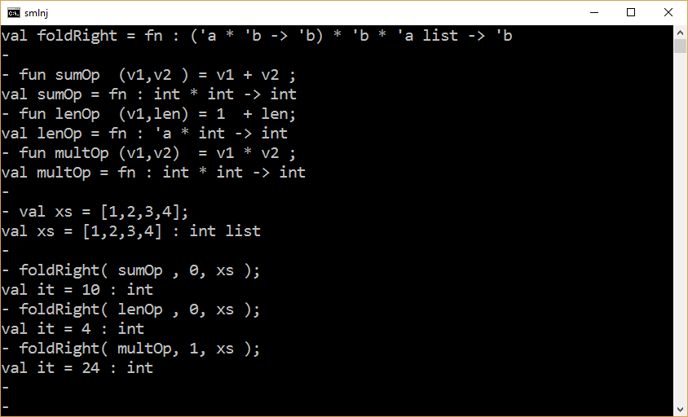

Slide 9
Count Evens
Write a function (and helper functions as needed), called countEvens, that is given a list of integers as input and returns the number of even integers in the list.
countEvens [] = 0
countEvens [1] = 0
countEvens [2] = 1
countEvens [1,2,3,4] = 2

Slide 10
fun countEvens [] = 0
| countEvens (x::xs) =
if x mod 2 = 0 then 1 + countEvens xs
else (* x is odd *) countEvens xs;
countEvens [1,2,3,4];

Slide 11
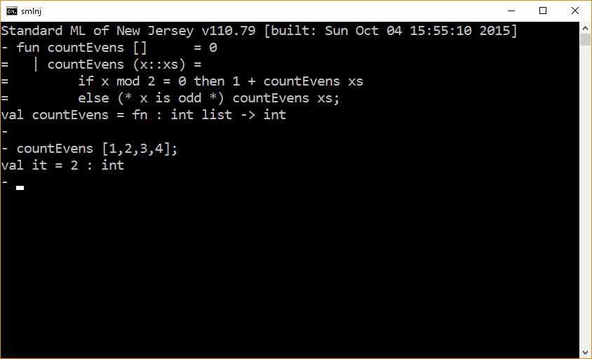

Slide 12
fun countEvens [] = 0
| countEvens (x::xs) =
(if x mod 2 = 0 then 1 else 0) + countEvens xs;
countEvens [1,2,3,4];
fun countEvens [] = 0
| countEvens (x::xs) =
let
val v = if x mod 2 = 0 then 1 else 0
in
v + countEvens xs
end;
countEvens [1,2,3,4];

Slide 13
fun isEven n = n mod 2 = 0;
fun countEvens [] = 0
| countEvens (x::xs) =
let
val v = if isEven x then 1 else 0
in
v + countEvens xs
end;
countEvens [1,2,3,4];

Slide 14
fun isEven n = n mod 2 = 0;
fun mapInt n = if isEven n then 1 else 0;
fun countEvens [] = 0
| countEvens (x::xs) = mapInt x + countEvens xs;
countEvens [1,2,3,4];

Slide 15
fun isEven n = n mod 2 = 0;
fun mapInt n = if isEven n then 1 else 0;
fun mapList [] = []
| mapList (x::xs) = mapInt x :: mapList xs;
fun sumList [] = 0
| sumList (x::xs) = x + sumList xs;
fun countEvens xs = sumList (mapList xs);
countEvens [1,2,3,4];

Slide 16
fun foldRight (opFn, v, xs) =
let
fun aux [] = v
| aux (x::xs) = opFn(x,aux xs)
in
aux xs
end;
fun isEven n = n mod 2 = 0;
fun mapInt n = if isEven n then 1 else 0;
fun countEven (v1,v2 ) = mapInt v1 + v2 ;
val xs = [1,2,3,4,5];
foldRight( countEven , 0, xs );

Slide 17
Important
With possibly an exception in the case of the project, this class is about programming in the small.
This class does not focus on issues surrounding reuse.
For the most part, the code that solves a problem should be written from scratch.
You should solve problems in a way that is clear and direct.
You should not construct solutions that sacrifice clarity and directness for the purposes of reuse.

Slide 18
fun isEven n = n mod 2 = 0;
fun allEvens [] = true
| allEvens (x::xs) = isEven x andalso allEvens xs;
allEvens [2,4,16,8];

Slide 19
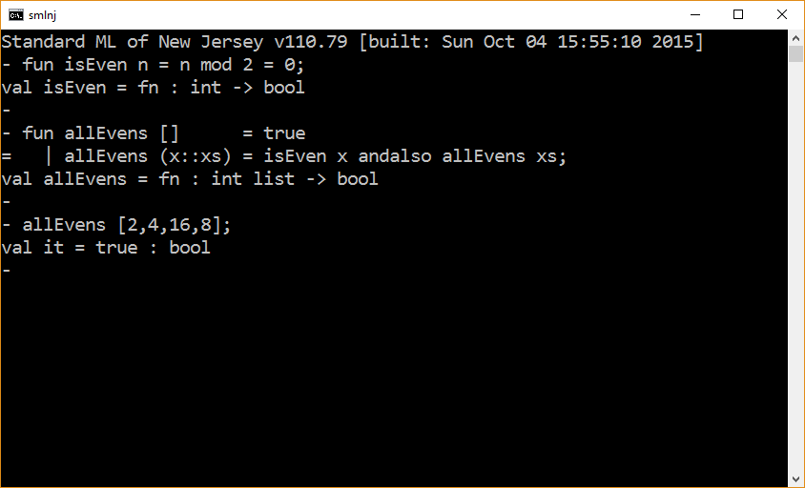

Slide 20
Example - Member
fun member (x, [] ) = false
| member (x, y::ys) = x = y orelse member(x, ys);
member (4, [1,2,3,4,5,6]);

Slide 21
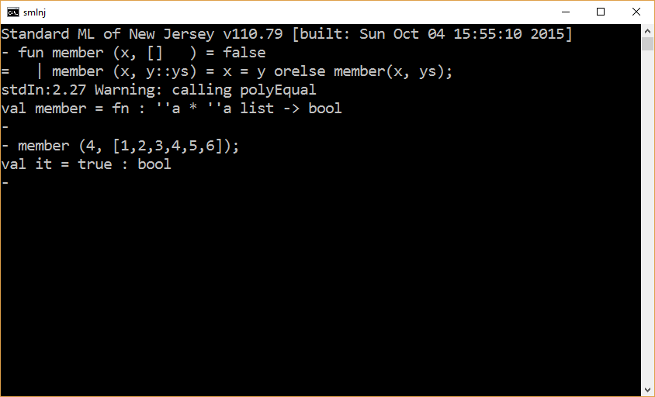

Slide 22
fun member (x, [] ) = false
| member (x, y::ys) = x = y orelse member(x, ys);
member (4, [1,2,3,4,5,6]);
fun member (x, [] ) = false
| member (x, y::ys) = if x = y then true
else member(x, ys);
member (4, [1,2,3,4,5,6]);

Slide 23
The end

